Slide 1
Threat Detection Using Distributed Machine Learning and Shared Indicators of Compromise
Teddy Katayama
Advanced Security Research & Government
August 25, 2016

Slide 2
IoC Threat Detection Project – Road Map
Phase I – Deep Understanding of IoCs
Phase II – Machine Learning Analytics
Phase III – Platform for Shared Distribution of IoCs

Slide 3
Midterm Review

Slide 4
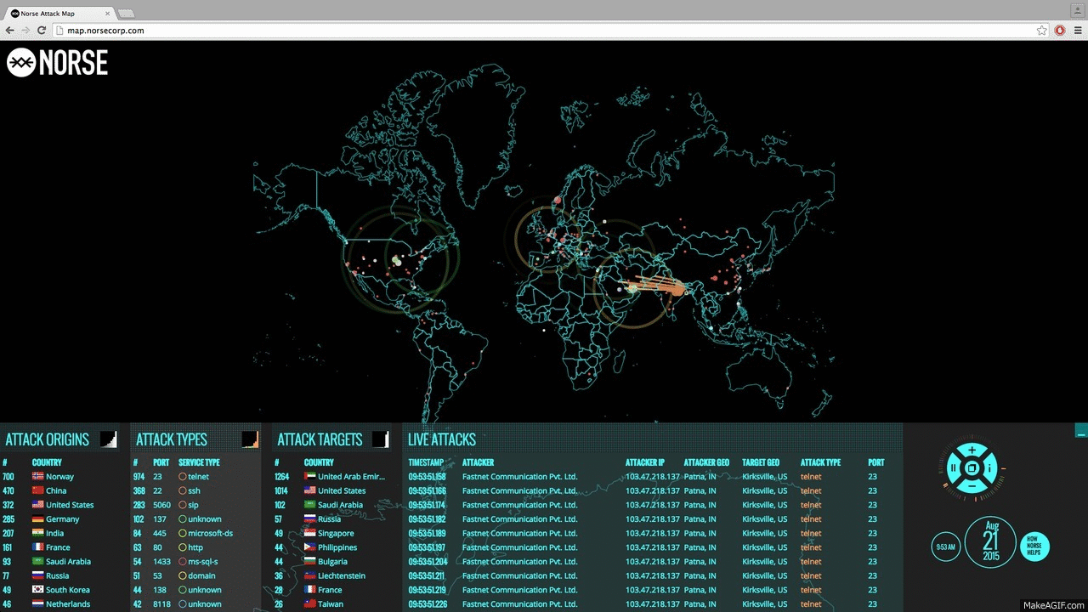
Overview of IoCs
Securing Systems
(Anti-Virus / Anti-Malware)
APTs (Advanced Persistent Threats)
Command and Control
Steal data
Ransomware
IoCs (Indicators of Compromise)
Artifacts left behind
Features
Sharing IoCs
Feeds (Spamhaus, Norse, LongTail, blogs, ...)
Collectors (ISACs, Firehol, Bambenek Consulting, ...)
Threat Intelligence (Cisco TIP, AlienVault OTX, Critical Stack, …)

Slide 5
Example IoCs

Slide 6
Example IoC – Pokemon Go
Threat Type: Adware
Package Name: net.ksbicrwkn.pokemongousa
MD5: d1d20271a6c8161f3cb920a4feba1faf Package Name: eu.auavcqwu.pokemongocoins
MD5: 2f5f3cf3bc1f0605662ba1cf5bf444c6
Threat Type: DroidJack component
Package Name: com.nianticlabs.pokemongo
MD5: d350cc8222792097317608ea95b283a8 Package Name: net.droidjack.server
MD5: 51b1872a8e2257c660e4f5b46412cb38 Threat Type: Installer
Package Name: com.thaipro.pokemongo
MD5: e0a1e087908c8150609cfc80963225d6 Package Name: com.vns.pokemongo
MD5: e4091d1d078192eadda60cab4729130a Package Name: com.vns.pokemongo
MD5: 09ef44df0faf3669809c302e5c05af3e
130.211.127.186
186.127.211.130 | 211.103.199.98
88.198.71.83 | 49.231.211.193
202.103.224.85 | 83.143.80.227
203.141.196.145 | 61.156.43.106

Slide 8
Example IoC Banker Trojan 2016 Olympics

Slide 9
IoC Data Mining and Processing Challenges
Exported with various formats
yaml, xml, json, openioc, csv, binaries, pdf, etc.
Distributed using various methods
SQL, taxi, proprietary APIs, web queries, etc.
Contains different levels of granularity
Ip, port, attack type, timestamp, age, etc.
Millions of data sets
thousands of sources, reputation, etc.
No standard protocol
format, information, shared distribution, usage

Slide 10
IoC Threat Detection – Phase 1

Slide 11
IoC Classification Types
CIDR –---- 2,295,625
CVE --------– 1,145
Domain -– 92,351,606
Email –----- 375,680
File Path –----- 213
File Name -– 126,042
Hash ------------ 42
Hostname –-- 55,329
Imphash –-------- 4
IPv4 –- 107,247,066
IPv6 –------- 1,082
Md5 –---- 1,334,591
Mutex –--------- 92
Regkey –---- 22,115
Sha1 –------ 156,530
Sha256 ----– 194,247
Ssdeep –----- 74,954
String –----- 24,192
URI -------– 108,994
URL –----- 4,991,580
useragent --– 17,015
Total IoCs = 209,378,144

Slide 12
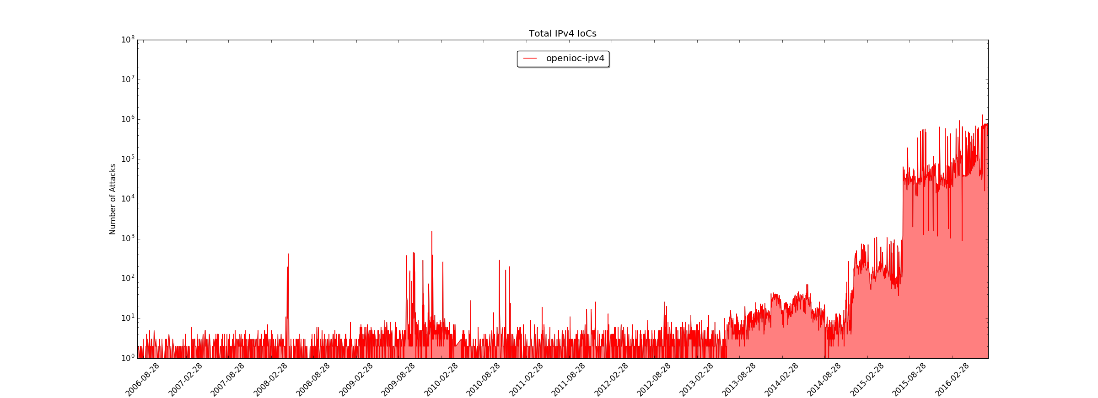
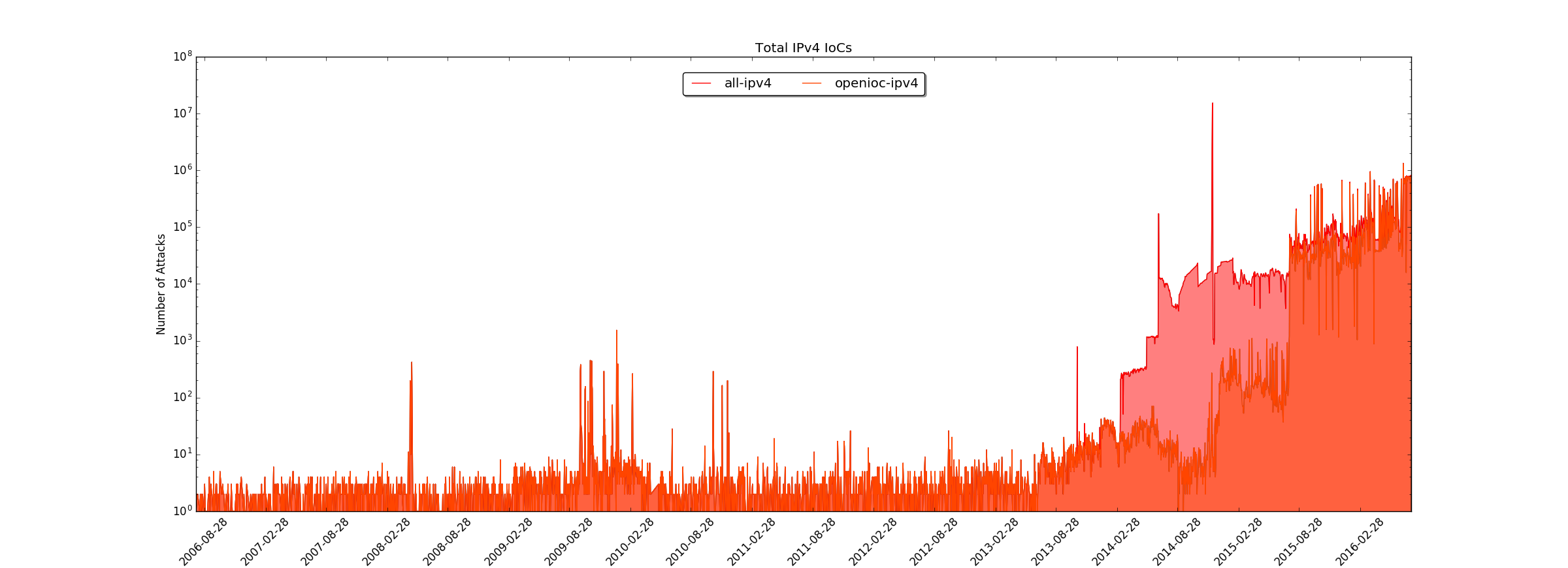
IPv4 IoCs from 2006 - 2016

Slide 13
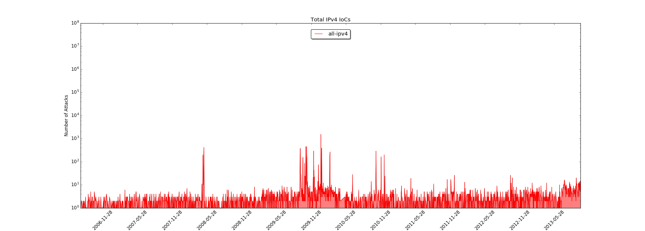
2006-08-03 – 2013-10-13
Charles Haley – ssh dictionary attacks

Slide 14
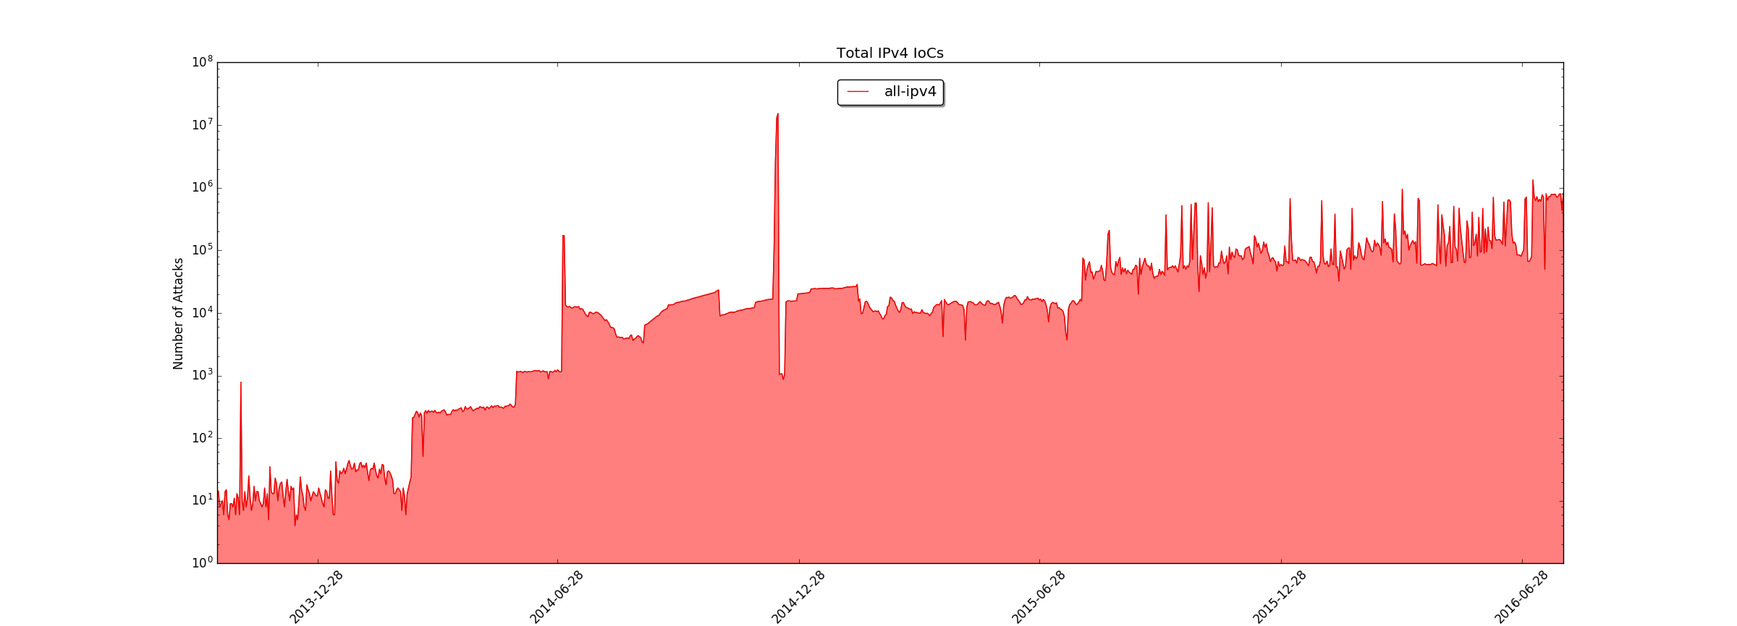
2013-10-13 – Present Day

Slide 15
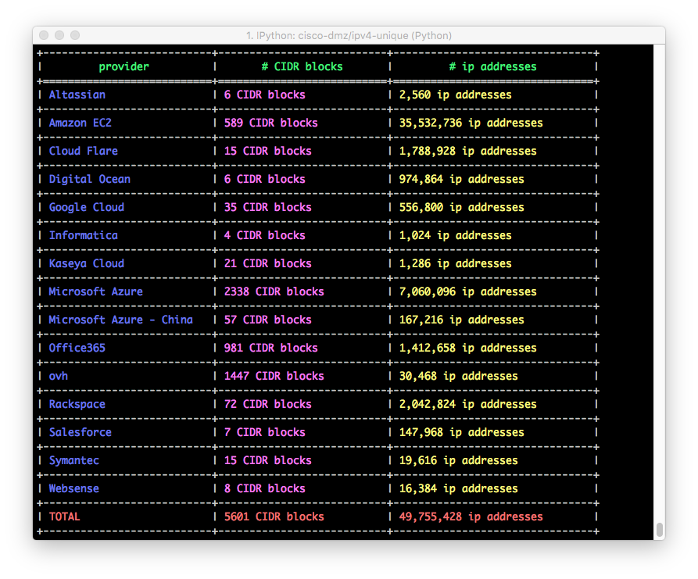
Cloud IPv4 Addresses

Slide 16
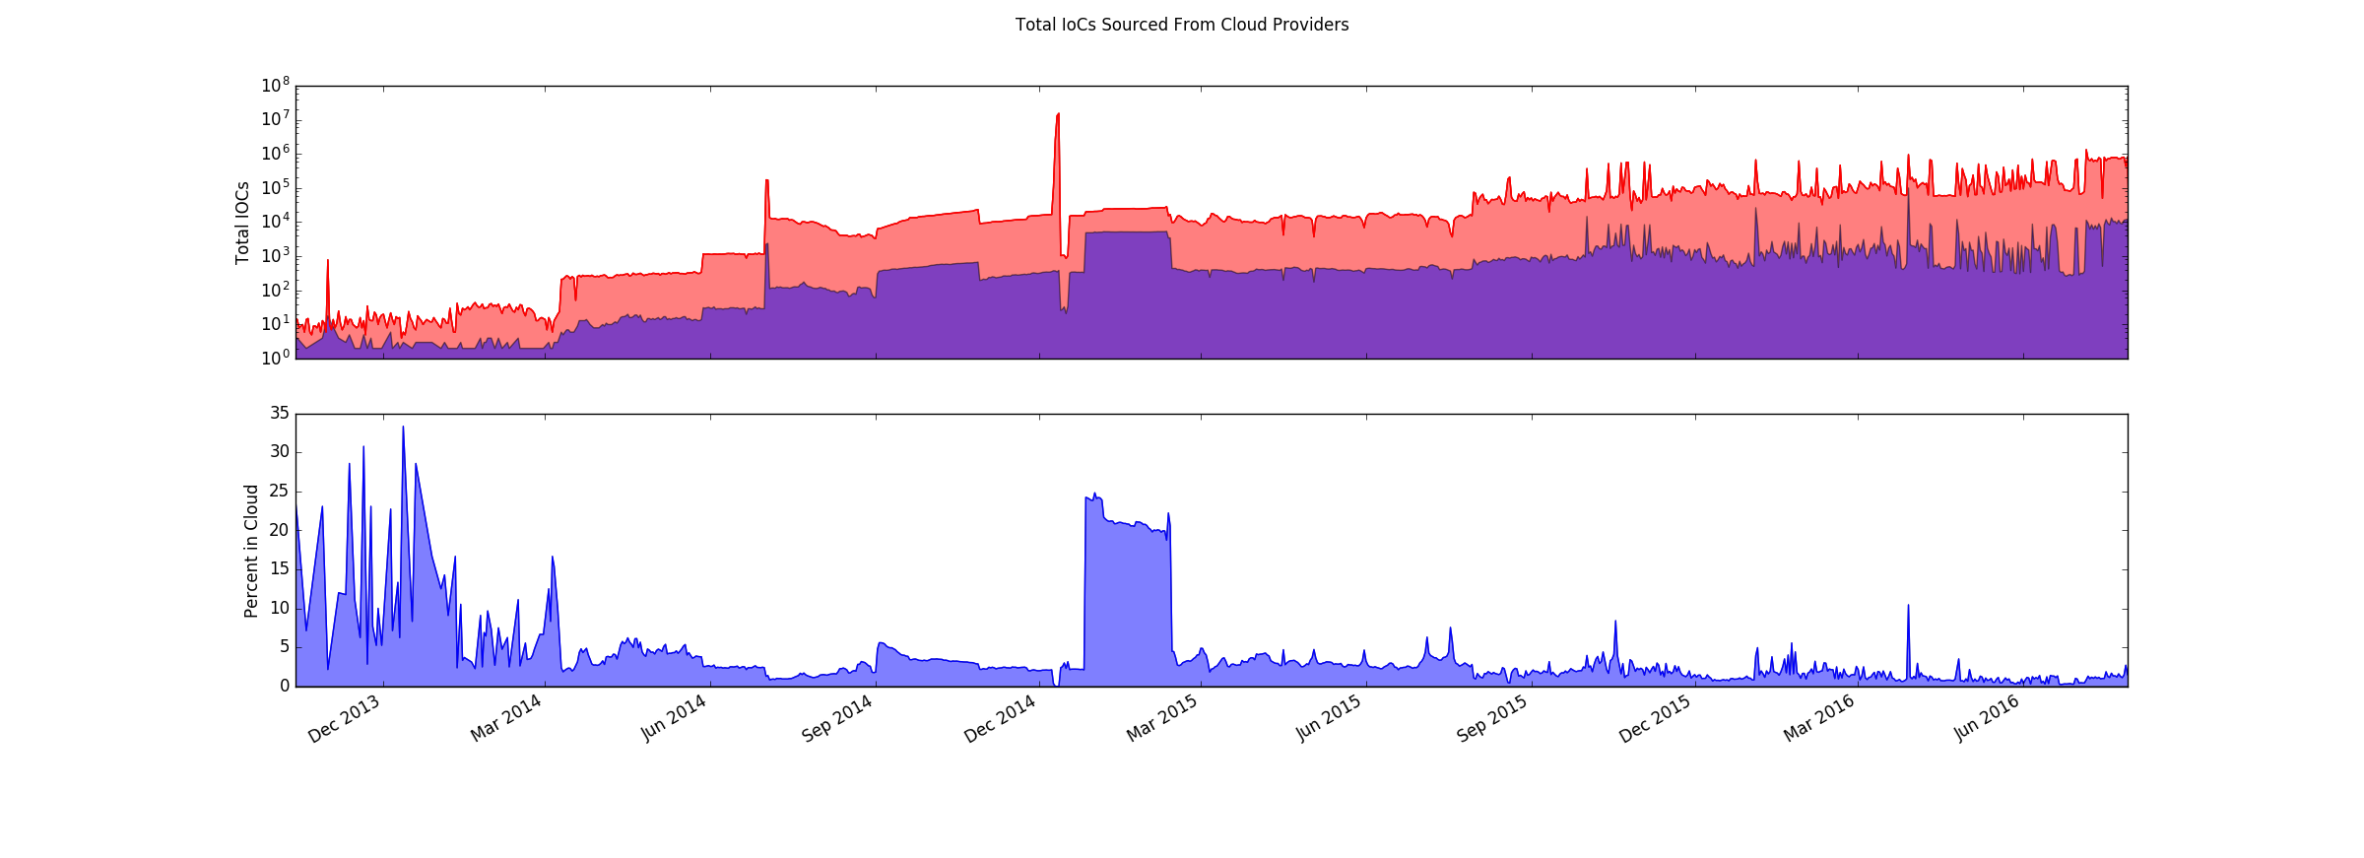
2013-10-13 – Present Day
600k
10k

Slide 17
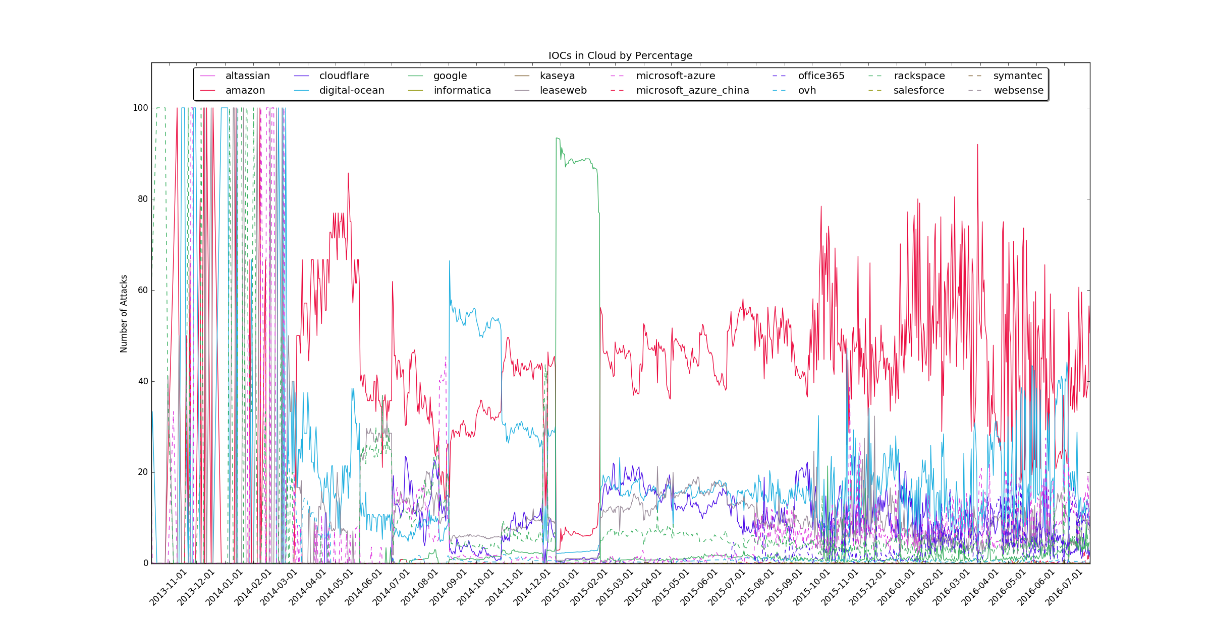

Savitzky Golay Filter
Notes:
It uses least squares to regress a small window of your data onto a polynomial, then uses the polynomial to estimate the point in the center of the window. Finally the window is shifted forward by one data point and the process repeats. This continues until every point has been optimally adjusted relative to its neighbors.

Slide 18
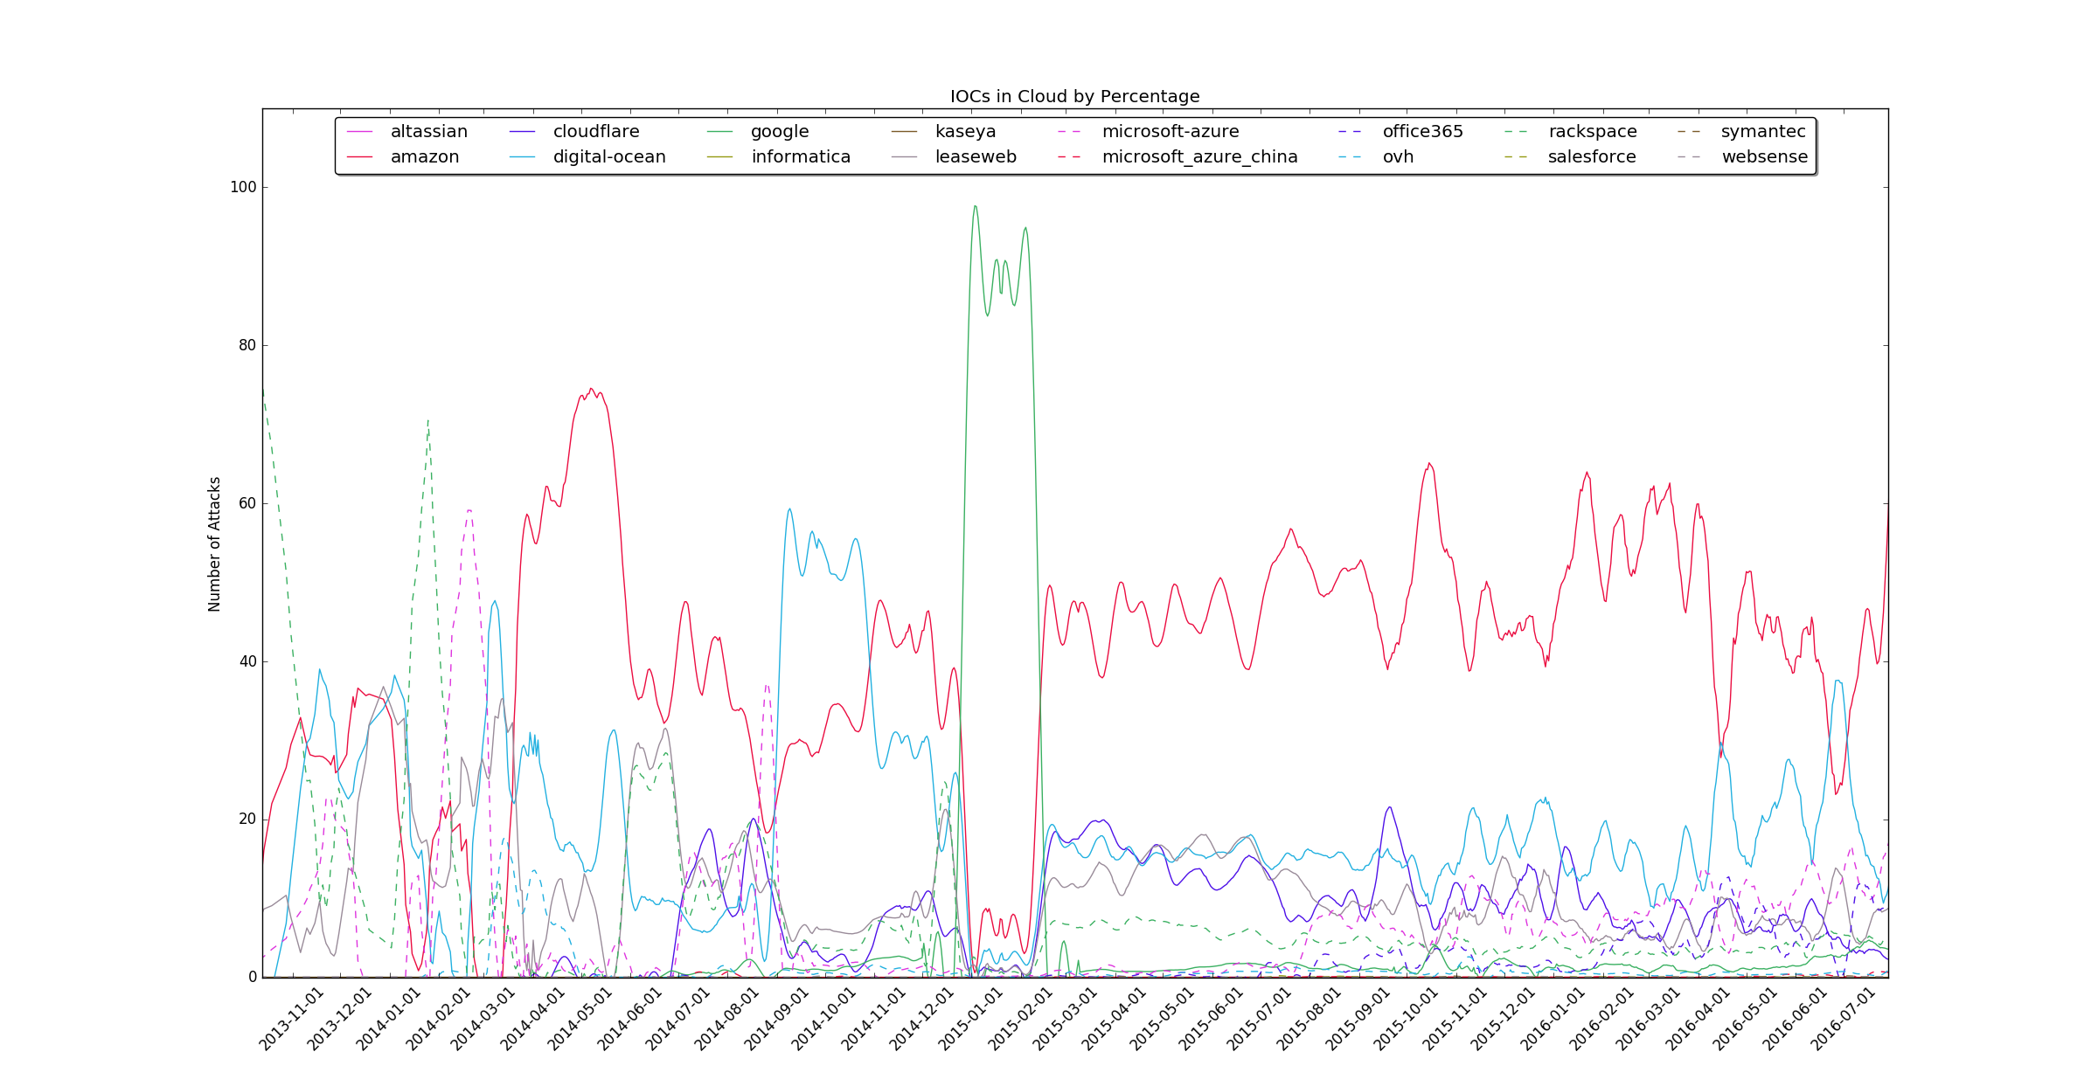
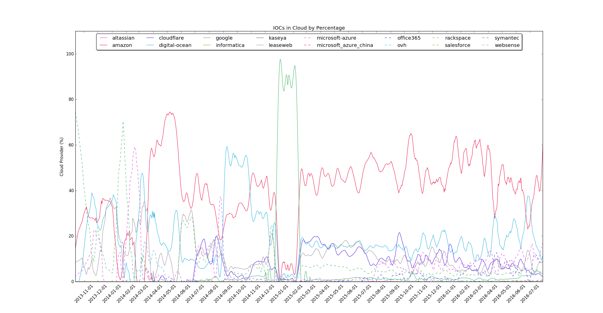

Slide 19
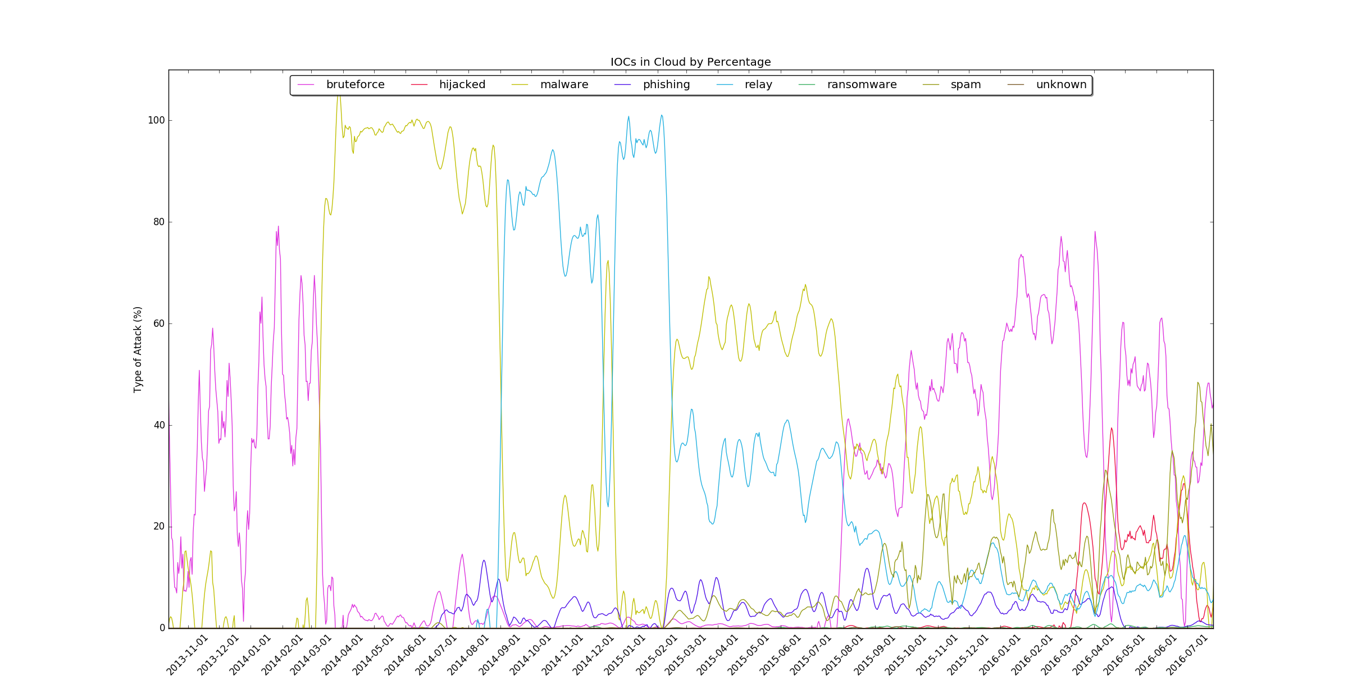

Slide 20
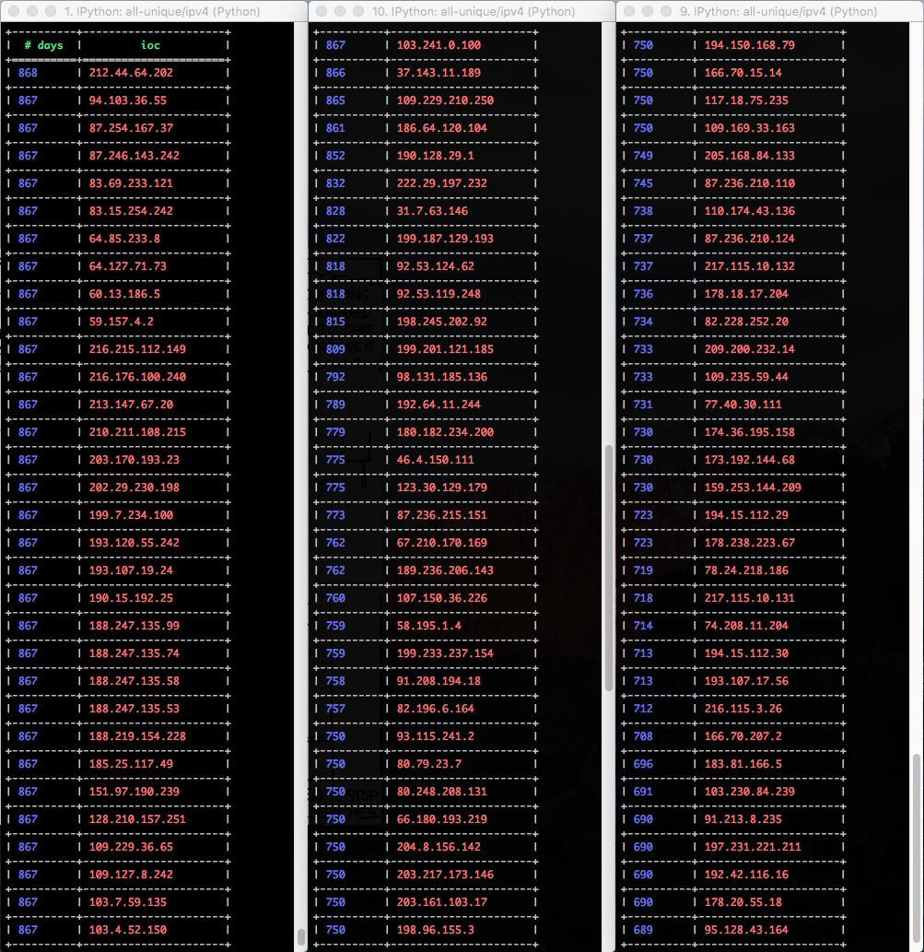
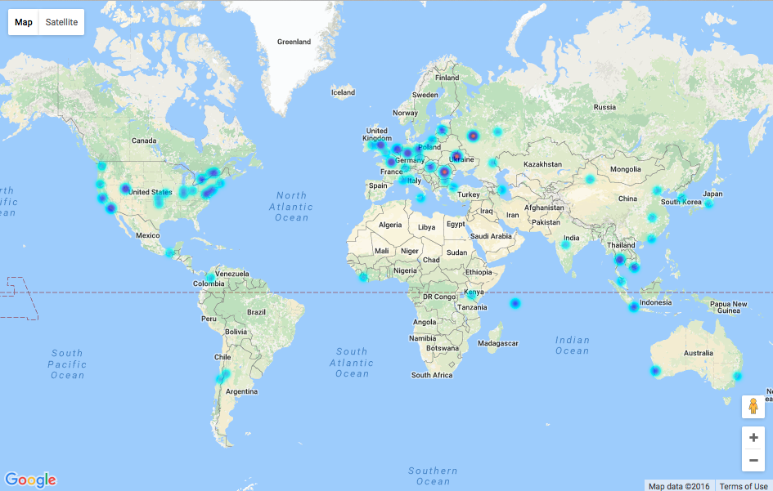
Top 100 IoCs

Slide 21
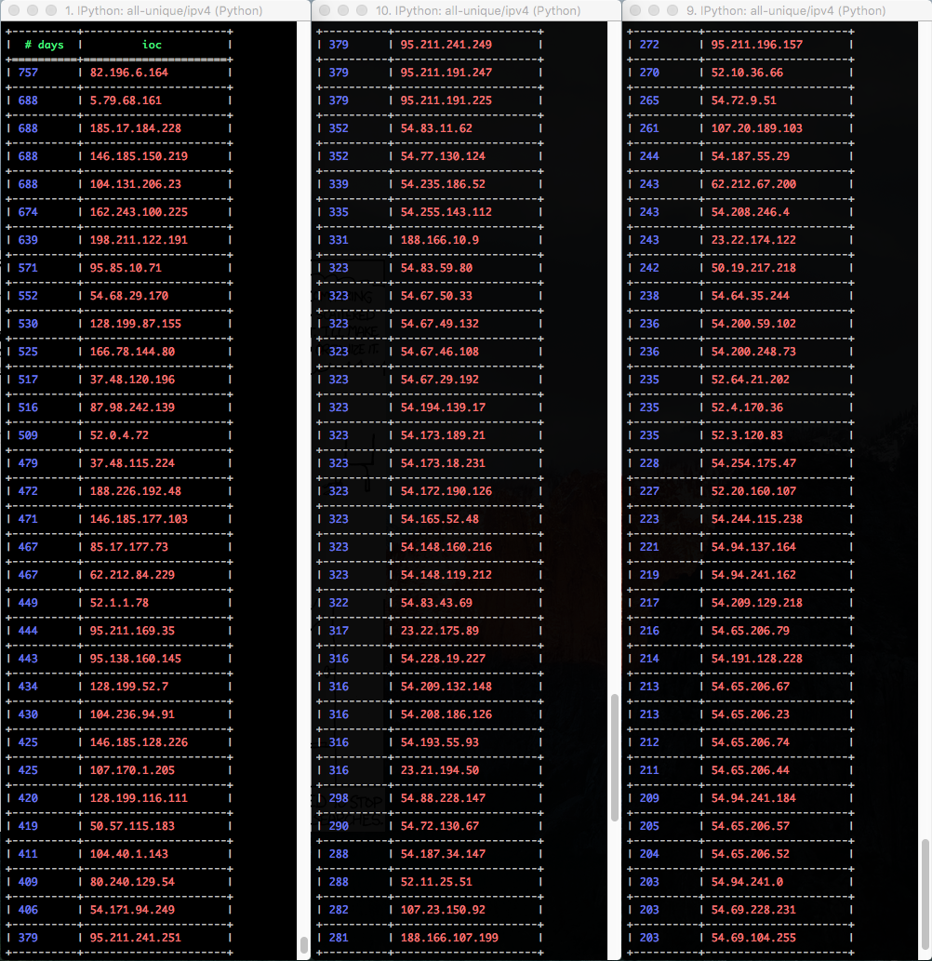
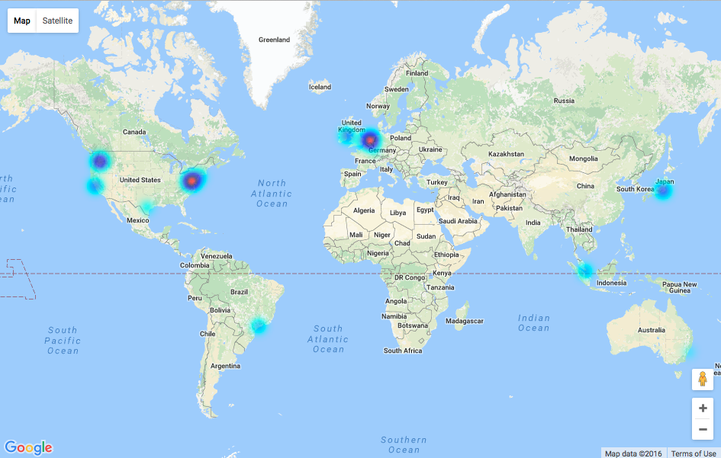
Top 100 IoCs – Cloud Hosted

Slide 22
Case Studies

Slide 23
IoC Case Study
Correlate Cisco DMZ flows characteristics with IoCs
IoCs visible in flows
IoCs sourced from cloud providers

Slide 24
Statistics
July 23, 2016 IoCs Seen in Cisco DMZ Flows
Bad IP Addresses
From the Cloud
209.126.103.42 295,276
93.174.93.94 170,423
177.82.185.149 119,744
209.126.120.54 60,358
61.240.144.66 50,441
209.126.127.156 45,618
61.240.144.65 37,273
185.94.111.1 30,439
45.58.113.205 30,373
69.172.216.55 30,317
amazon 77,065
ovh 49,639
leaseweb 12,914
office365 5,293
cloudflare 3,037
rackspace 2,475
microsoft-azure 1,029
digital-ocean 48
google 43
microsoft-china 3
Total Flows: 9,400,302
Total Bad To-Cloud: 9,342
Total Blacklisted: 378,038
Unique Blacklisted: 8,996

Slide 25
IoC Threat Detection – Phase 2

Slide 26
IoC Case Study
Integrate IoC filter with Enhanced Telemetry Encrypted Malware Classifier
Compare protocols seen from classifier with reported IoC source
Examine HTTP header fields
OS fingerprinting and TLS client/server fingerprinting
Help reduce false positives?
Help reduce alarms?

Slide 27



Problem: encrypted traffic
Premises
Internet
String-matching solutions ineffective
Snort, OpenAppID, NBAR, …
TLS (and other encryption) usage increase
Benign and malware
MITM problems: deployment, expense, privacy

Slide 28


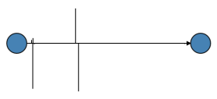
Flow classification
IoC
Filter
Classifier
Flow
Records
Notes:
ML Classifiers, rules

Slide 29
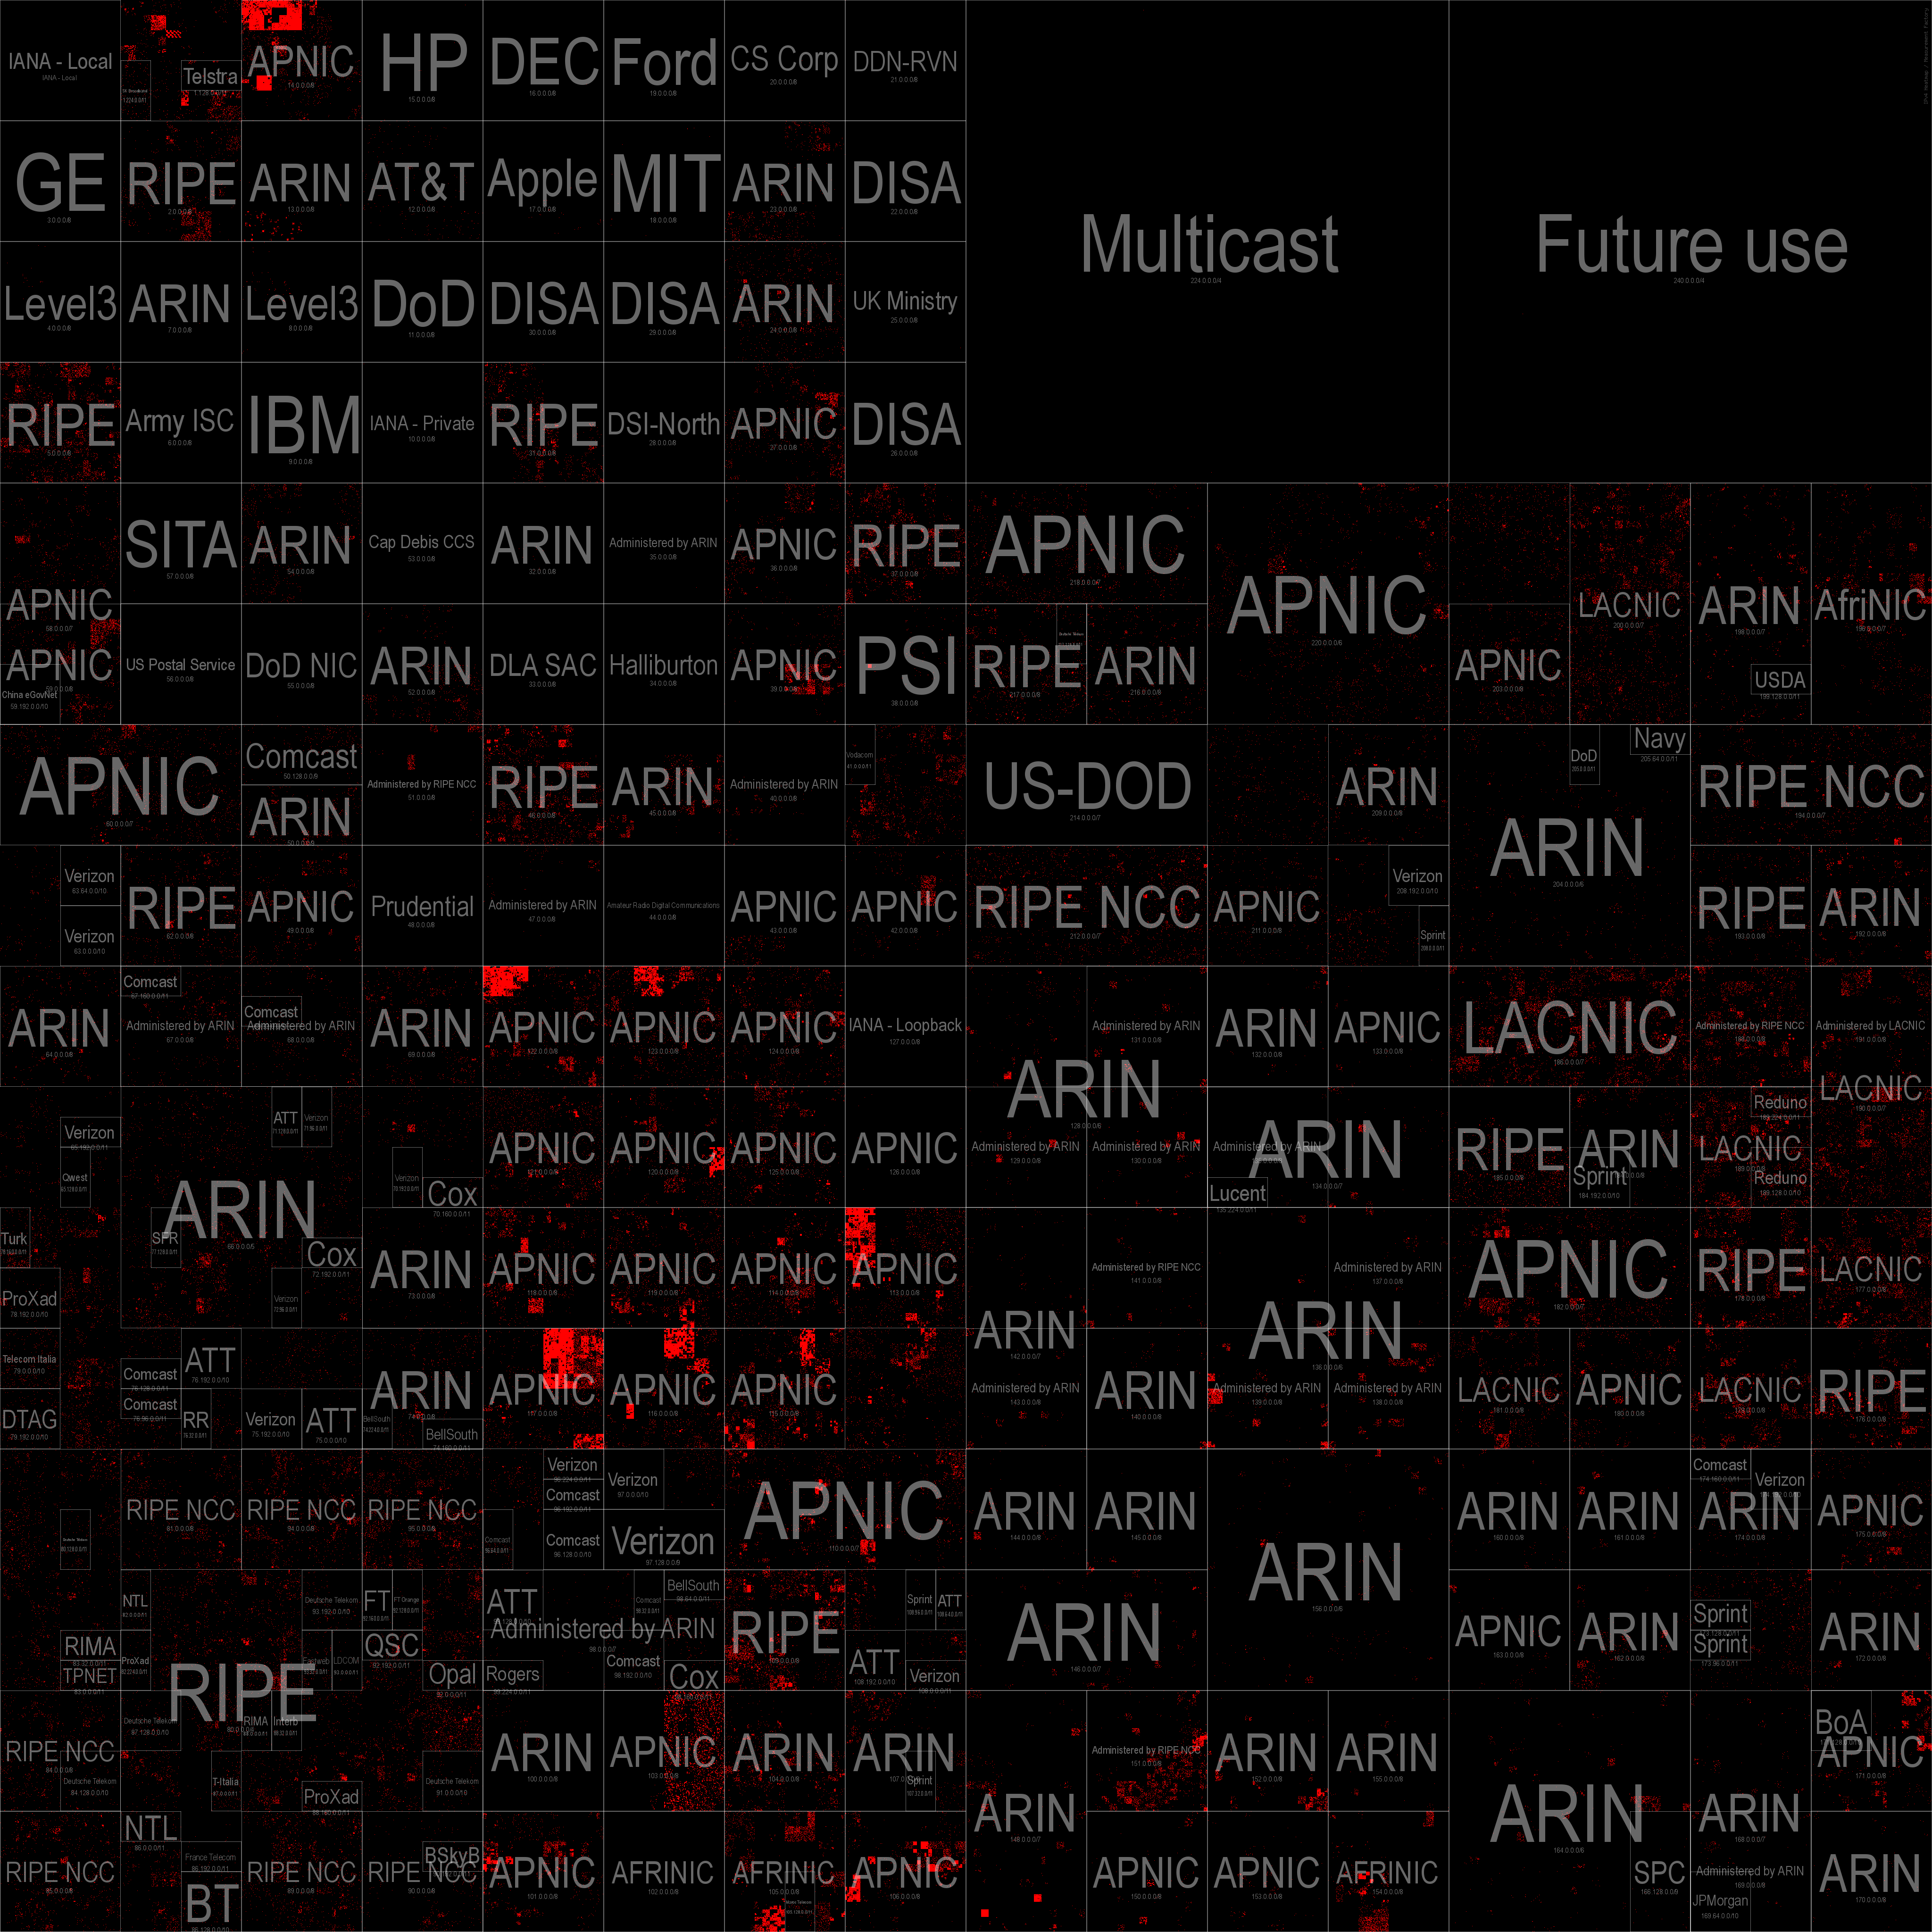
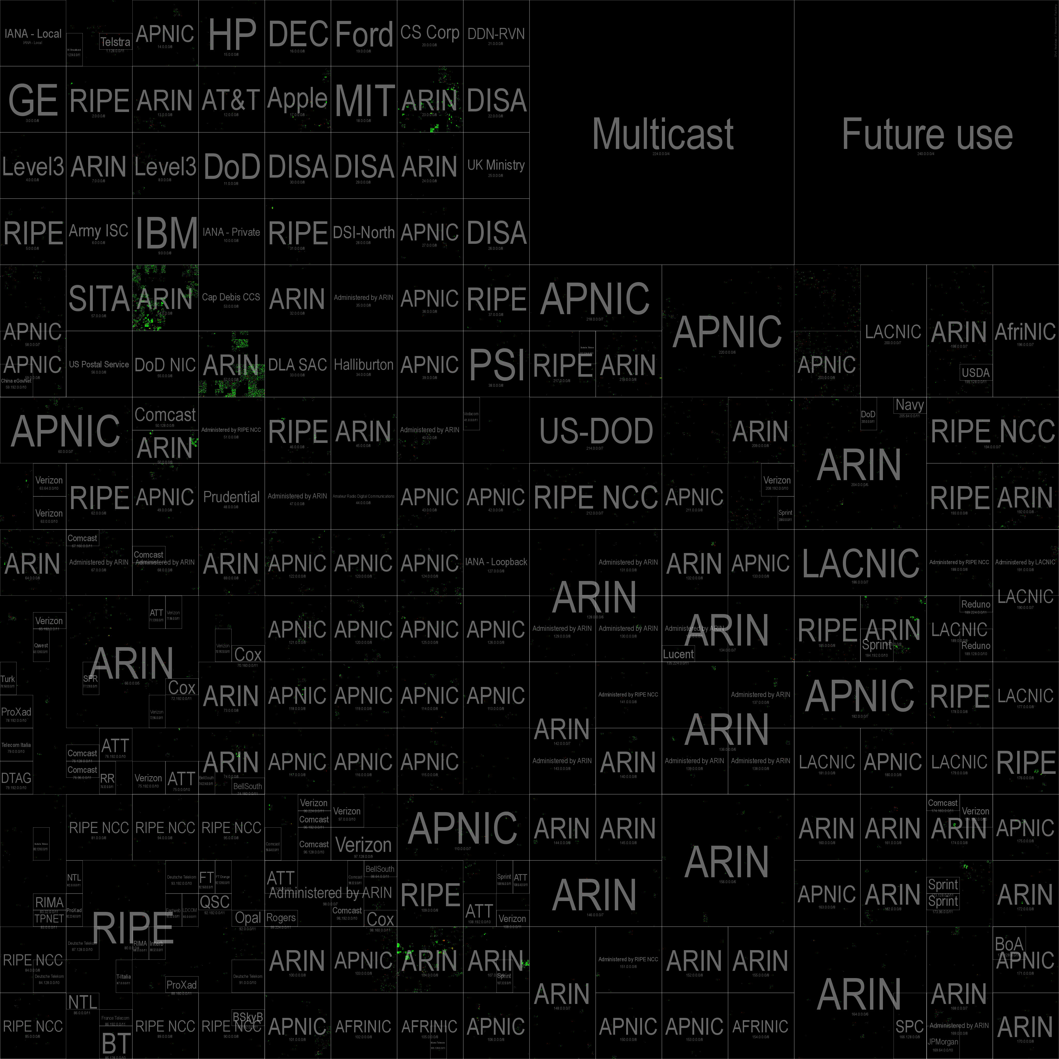
Total IoCs
Cisco DMZ Traffic

Slide 30
Cisco DMZ Communication – July 25, 2016

Slide 31
Cisco DMZ Total Positive – July 25, 2016

Slide 32
Case Study – Filtered IoC Results
7,901,482 – total flows
19,536 – alarms
221 – IoC filtered alarms
(25) – unique IPs
Significant reduction of alarms
Reasonable size to work with
Allows a network analyst to conduct deeper investigation
Should an event be escalated?

Slide 33
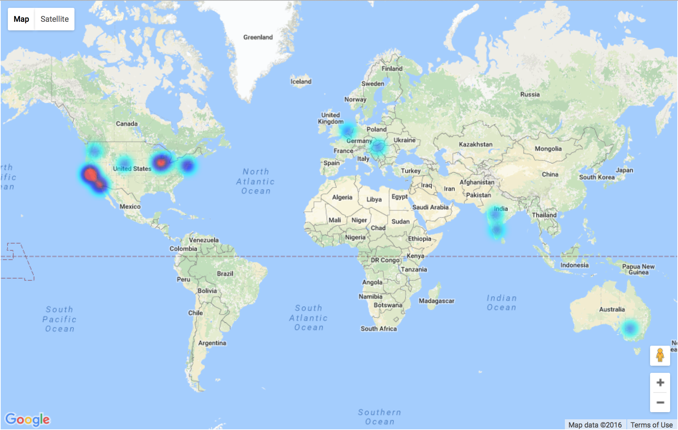
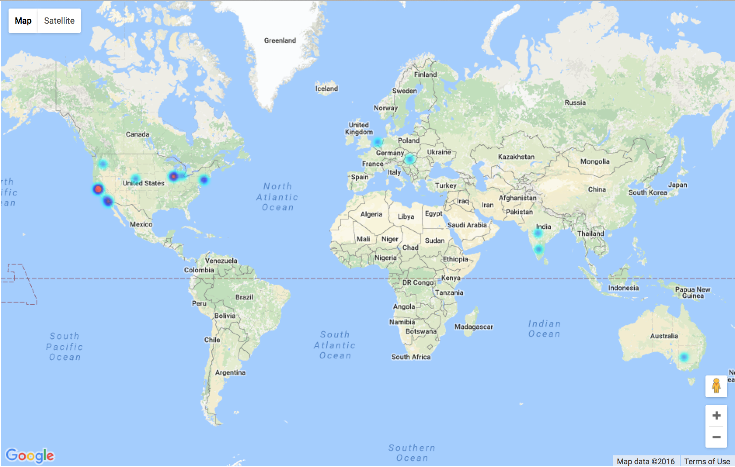
Cisco DMZ Filtered Positive – July 25, 2016

Slide 34
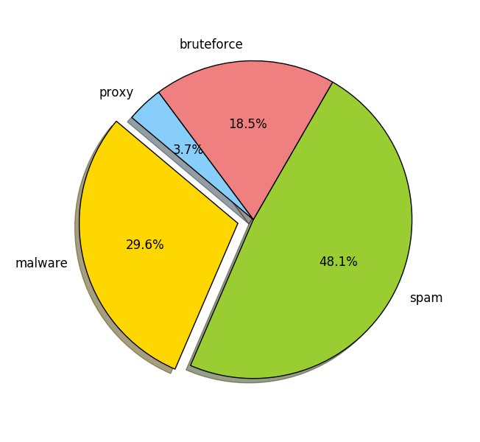
Filtered Positive Results by Attack Type

Slide 35
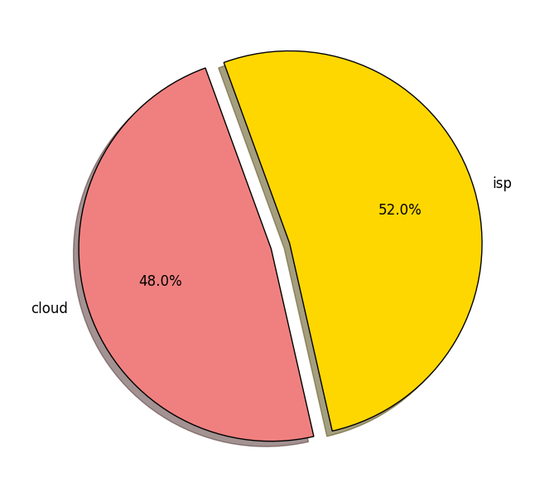
Filtered Positive Results – Cloud Providers
Amazon EC2
ServerCentral
Microsoft Azure
CariNet
AppNexus
EdgeCast
SingleHop
CacheFly

Slide 36
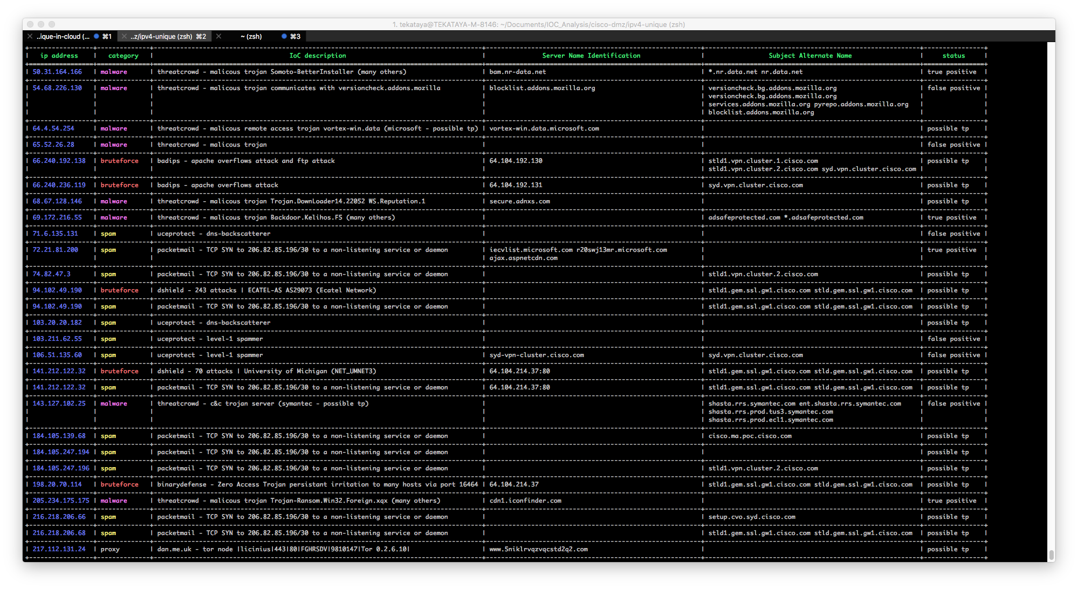

Slide 37
IoC Threat Detection Project – Road Map
Phase I – Deep Understanding of IoCs
Phase II – Machine Learning Analytics
Phase III – Platform for Shared Distribution of IoCs

Slide 38
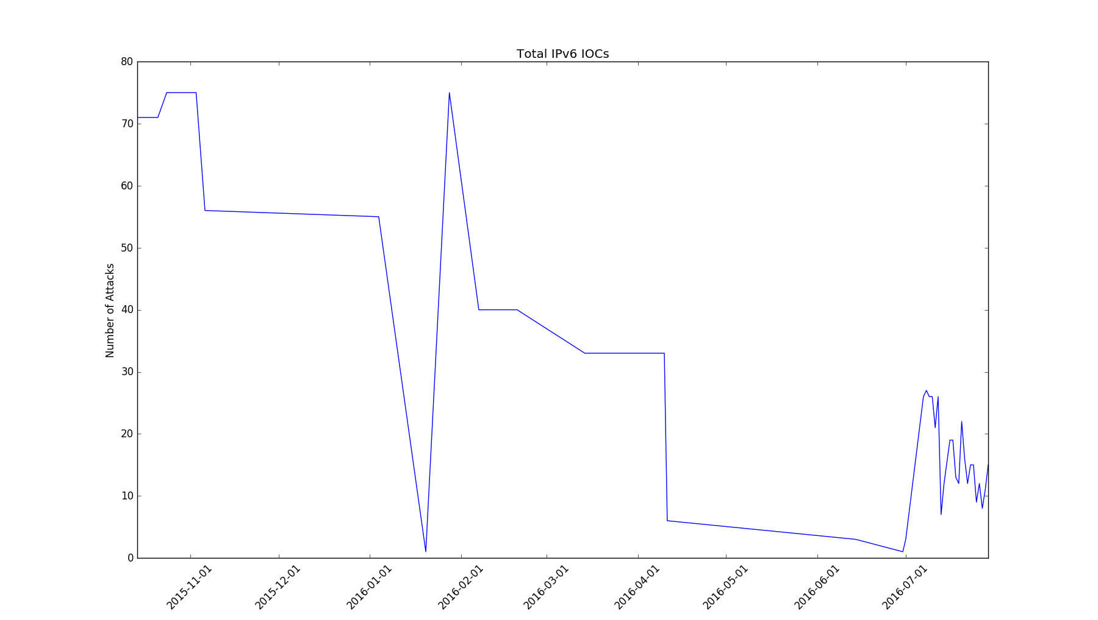
Future Work

Slide 39
Cisco Experience

Slide 40
Collaborators
Steve Rich
Roger Seagle
Blake Anderson
David McGrew
Jim Warren
Tony Jeffs
Mike Cantrell
Pablo Moriano

Slide 41
Tools & Data
Cisco TIP
Map Reduce / Hadoop
Hbase
IoC data
joy
pcap2flow
enhanced telemetry flow classifier
machine learning
real world flows
flow_parser
classify_tls

Slide 42
Things I Liked
Positive Environment
Friendly Staff
Great Interns
Equipment Availability
Telepresence / WebEx

Slide 43
Improvements
More interaction with other interns
Local social events

